Slide 1

Introduction to Natural Language Processing in the Social Sciences

Slide 2
Learning outcomes
At the other end of this class, you should:
Be familiar with important terminology and ideas in NLP
Know what text analysis method you can use to answer your research question.
Know what steps are involved in preprocessing data for NLP
Know some common NLP methods
Know pros/cons with different ways of doing NLP

Slide 3
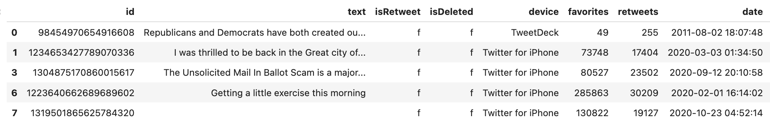
this will be in the workshop!
I will present various data analyses of Trump’s tweets in this lecture
But I haven’t done proper preprocessing
Your job in the workshop will be to fix the preprocessing!

Slide 4

Today’s class
Situating NLP in text analysis
Data cleaning & preprocessing
Text representation / Vectorization
Sentiment analysis
Topic modeling
Machine learning
Large Language Models

Slide 5
Today’s class
Situating NLP in text analysis
Data cleaning & preprocessing
Text representation / Vectorization
Sentiment analysis
Topic modeling
Machine learning
Large Language Models

Slide 6
Situating NLP
There are different traditions of text analysis in the social sciences.
1. Qualitative text analysis
2. Quantitative text analysis
3. Natural Language Processing

Slide 7
Qualitative text analysis
e.g. critical discourse analysis
“Read attentively and draw conclusions based on your theoretical knowledge”
Michel Foucault: Power/knowledge through language.
Erving Goffman: Everyday conversation and "frame analysis".
Teun A. van Dijk & Norman Fairclough: Critical discourse analysis focusing on power and ideology.
Purpose of Discourse Analysis: To understand language in action, its assumptions, framing of issues, and the empowerment or disenfranchisement it may entail.
Pro: High reliability. Deep, theoretically grounded analysis.
Con: Low validity. Can’t handle large data. Lack of rigor. Cherry-picking.

Slide 8
Examples qualitative research questions:
1. How did Donald Trump's Twitter discourse construct and represent his political identity and that of his adversaries during his presidency?
2. How did Donald Trump's Twitter messages utilize rhetorical strategies to frame discussions of immigration policy? How does his characterization of migrant groups fit into longer histories of othering in the US context?
3. How did Donald Trump’s construct a separation between in-group and out-group among his political followers?
4. What discursive strategies did Donald Trump employ in relation to media and the press?

Slide 9
Quantitative methods
e.g. Corpus Linguistics
“Turn language into numbers and do statistics!”
Counting and Measuring:
Conversion of qualitative data to quantitative metrics
E.g., word frequency, sentence length, readability, word co-occurrence
Chi-Square Tests. Z-score.
Deductive: make hypotheses and test
Pro: High validity. Can be used on large text data.
Con: Low reliability, “shallow” analysis.

Slide 10



Example quantitative research questions:
How has the level of similarity between British English and American English changed over time?
Has the use of gender-neutral pronouns in English language newspapers increased over the last decade?
Are there differences in the words used by men and women in job applications?
What are the predominant grammatical structures used in spoken versus written English?
How does the use of passive voice in scientific writing compare across different disciplines?
Do people use more markers of politeness (“please”, “thank you”) in the US South than in the North?

Slide 11

Natural Language Processing
New field at the intersection of computer science, artificial intelligence, and linguistics
One of the most important method of Computational Social Science
Often doesn’t fit into the classic quant-qual divide
Mostly combined with quantitative approach, but can just as well be used qualitatively
Predict, classify, cluster
In-depth and large scale

Slide 12

Examples of NLP methods
Sentiment analysis: Identify the feelings expressed in a given text.
Topic modeling: Unsupervised method to identify themes from textual data.
Machine Translation: Translate from one language to another
Named Entity Recognition (NER): Identify all the people and objects in a text.
Machine Learning: Make predictions, automatically annotate data.
NLP often involves a combination of several techniques to carry out some specific task.

Slide 13


Examples research questions:
Can we predict how stocks will go up or down on the stock market based on what Donald Trump writes on Twitter?
Did Donald Trump’s tweets become more emotionally negative over time?
Can we predict who will win an election based on what people write on Twitter?
Did Trump’s Twitter messages result in a spread of misinformation among his followers?
Does a high level of toxicity and incivility in the language of Trump’s tweets result in more engagement from his followers?
Did Trump focus on specific topics before elections, such as migration?
NLP can be combined with qual or quant approach!

Slide 14
Discuss with your neighbor: - What approach would you take to answer the following questions? - Suggest an additional research question and how it can be answered.
1. Did Trump focus on specific issues in response to negative news during his presidency?
3. What fraction of Donald Trump’s tweets contains attacks of political opponents?
3. How did Donald Trump construct his public identity through his Twitter messages?

Slide 15
Today’s class
Situating NLP in text analysis
Data cleaning & preprocessing
Text representation / Vectorization
Sentiment analysis
Topic modeling
Machine learning
Large Language Models

Slide 16

Step 0. Data cleaning
Remove duplicates
Remove rows with missing data
Fill in missing data
Remove outliers
Harmonize data
Fix data types

Slide 17
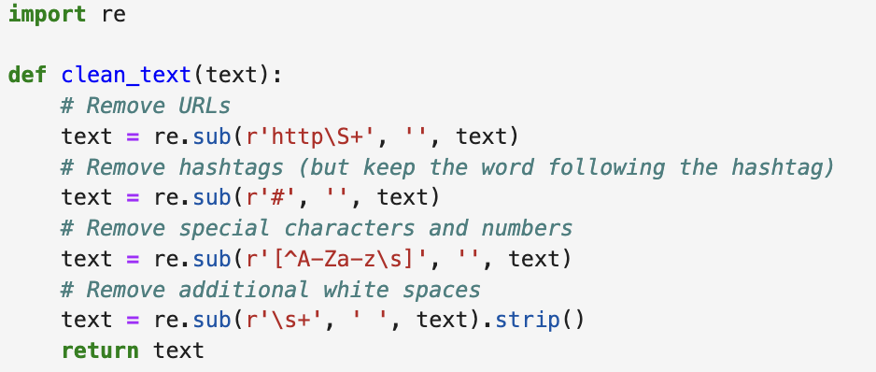
Step 1. Text cleaning: Remove HTML tags, URLs, numbers, etc.
The first step is to clean the text. We remove any irrelevant items like HTML tags, URLs, and codes when dealing with web data. We also get rid of special characters, numbers, or punctuation that might not be necessary for analysis.
We might want to drop rows with retweets, posts with URL, mentions, short messages!
“So now the Fake News @nytimes is tracing the CoronaVirus origins back to Europe, NOT China. This is a first! #fakenews
I wonder what the Failing New York Times got for this one? Are there any NAMED sources? They were recently thrown out of China like dogs, and obviously want back in. Sad! https://t.co/4qwCKQOiOw”
“So now the Fake News nytimes is tracing the CoronaVirus origins back to Europe NOT China This is a first fakenews I wonder what the Failing New York Times got for this one Are there any NAMED sources They were recently thrown out of China like dogs and obviously want back in Sad”

Slide 18
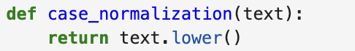
Step 2: Case normalization
Next, we normalize the case by converting all the text to lower case. This ensures that words like 'House', 'house', and 'HOUSE' are all treated as the same word, preventing the model from treating them as different entities.
“So now the Fake News nytimes is tracing the CoronaVirus origins back to Europe NOT China This is a first fakenews I wonder what the Failing New York Times got for this one Are there any NAMED sources They were recently thrown out of China like dogs and obviously want back in Sad”
“so now the fake news nytimes is tracing the coronavirus origins back to europe not china this is a first fakenews i wonder what the failing new york times got for this one are there any named sources they were recently thrown out of china like dogs and obviously want back in sad”

Slide 19
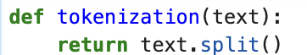
Step 3: Tokenization
Then we move to tokenization. This is where we break down the text into smaller pieces, or tokens.
Tokens can be words, phrases, or even sentences. In English, this might seem as simple as splitting by spaces, but it can get complicated with languages that don’t use spaces or have complex morphology.
A key problem is that words like “United States” are split as well. n-gram allows identifying words that belong together.
United_States.
“so now the fake news nytimes is tracing the coronavirus origins back to europe not china this is a first fakenews i wonder what the failing new york times got for this one are there any named sources they were recently thrown out of china like dogs and obviously want back in sad”
['so', 'now', 'the', 'fake', 'news', 'nytimes', 'is', 'tracing', 'the', 'coronavirus', 'origins', 'back', 'to', 'europe', 'not', 'china', 'this', 'is', 'a', 'first', 'fakenews', 'i', 'wonder', 'what', 'the', 'failing', 'new', 'york', 'times', 'got', 'for', 'this', 'one', 'are', 'there', 'any', 'named', 'sources', 'they', 'were', 'recently', 'thrown', 'out', 'of', 'china', 'like', 'dogs', 'and', 'obviously', 'want', 'back', 'in', 'sad']

Slide 20
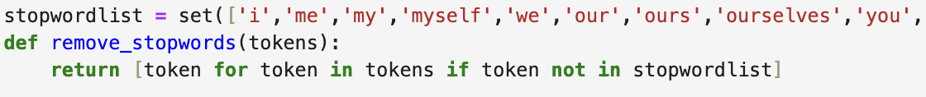
Step 4: Stop Words Removal
After tokenization, we often remove stop words.
These are common words like 'is', 'and', 'the', which appear frequently in the text but usually don’t carry significant meaning for the analysis.
['so', 'now', 'the', 'fake', 'news', 'nytimes', 'is', 'tracing', 'the', 'coronavirus', 'origins', 'back', 'to', 'europe', 'not', 'china', 'this', 'is', 'a', 'first', 'fakenews', 'i', 'wonder', 'what', 'the', 'failing', 'new', 'york', 'times', 'got', 'for', 'this', 'one', 'are', 'there', 'any', 'named', 'sources', 'they', 'were', 'recently', 'thrown', 'out', 'of', 'china', 'like', 'dogs', 'and', 'obviously', 'want', 'back', 'in', 'sad']
['fake', 'news', 'nytimes', 'tracing', 'coronavirus', 'origins', 'back', 'europe', 'china', 'first', 'fakenews', 'wonder', 'failing', 'new', 'york', 'times', 'got', 'one', 'named', 'sources', 'recently', 'thrown', 'china', 'like', 'dogs', 'obviously', 'want', 'back', 'sad']

Slide 21
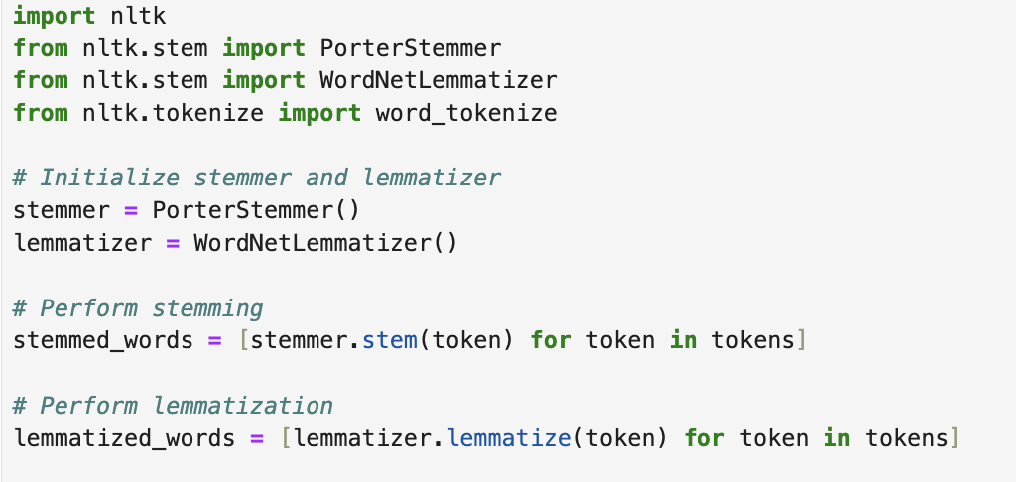
Step 5: Stemming or Lemmatization
Stemming and lemmatization are two forms of word normalization that are often performed in the fields of natural language processing and text mining.
Stemming typically involves removing the ends of words in the hope of achieving this goal more accurately and quickly, often with the aid of heuristics.
Lemmatization, uses vocabulary and morphological analysis to remove inflectional endings only and to return the base or dictionary form of a word, which is known as the “lemma”.
Stemmed : ['fake', 'news', 'nytim', 'trace', 'coronaviru', 'origin', 'back', 'europ', 'china', 'first', 'fakenew', 'wonder', 'fail', 'new', 'york', 'time', 'got', 'one', 'name', 'sourc', 'recent', 'thrown', 'china', 'like', 'dog', 'obvious', 'want', 'back', 'sad’]
Lemmatized: ['fake', 'news', 'nytimes', 'tracing', 'coronavirus', 'origin', 'back', 'europe', 'china', 'first', 'fakenews', 'wonder', 'failing', 'new', 'york', 'time', 'got', 'one', 'named', 'source', 'recently', 'thrown', 'china', 'like', 'dog', 'obviously', 'want', 'back', 'sad']
['fake', 'news', 'nytimes', 'tracing', 'coronavirus', 'origins', 'back', 'europe', 'china', 'first', 'fakenews', 'wonder', 'failing', 'new', 'york', 'times', 'got', 'one', 'named', 'sources', 'recently', 'thrown', 'china', 'like', 'dogs', 'obviously', 'want', 'back', 'sad']

Slide 22
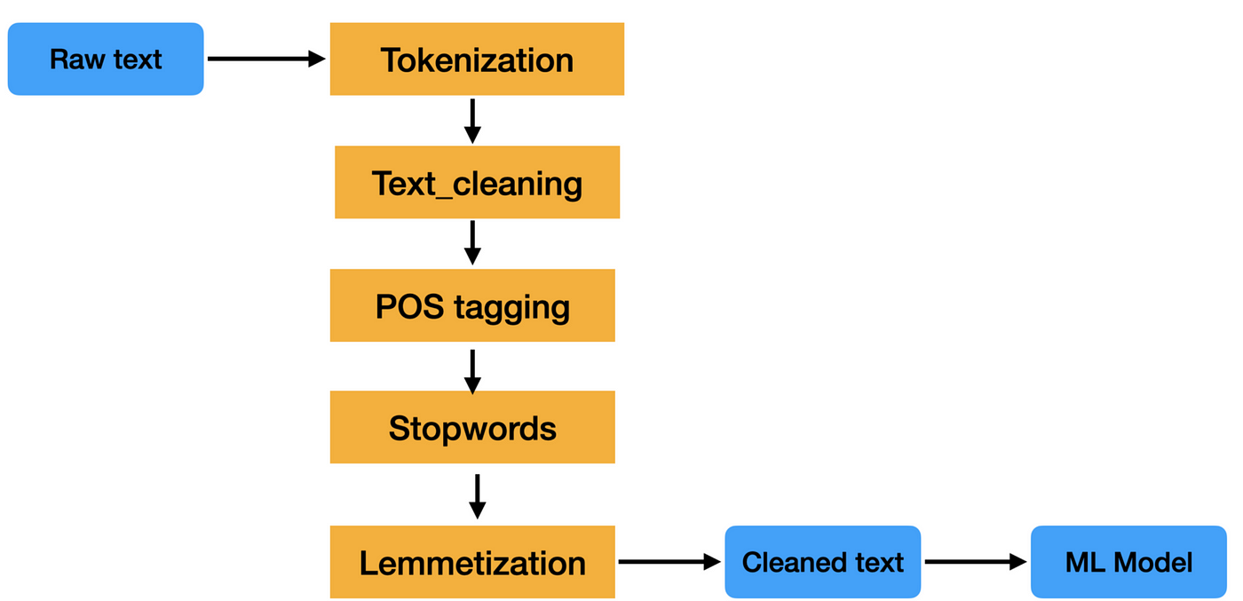
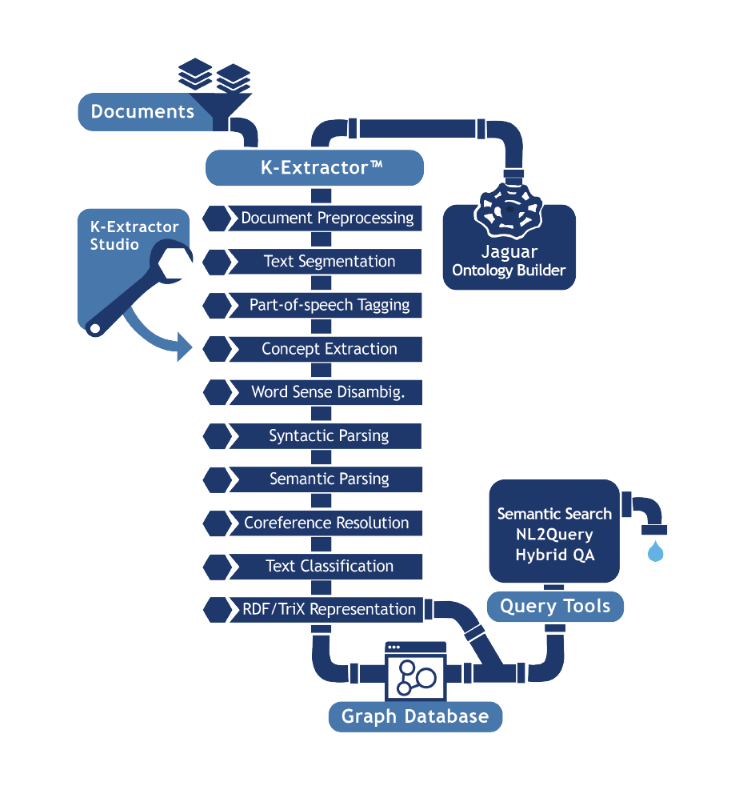
NLP pipelines
A data analysis pipeline refers to a series of systematically arranged processes or steps that data goes through from collection to the generation of insights or models.
VADER sentiment analysis
Raw text

Slide 23
Today’s class
Situating NLP in text analysis
Data cleaning & preprocessing
Text representation / Vectorization
Sentiment analysis
Topic modeling
Machine learning
Large Language Models

Slide 24

Text representation / Vectorization
Text representation or vectorization is a fundamental aspect of NLP that transforms text into a format that machines can understand and process.
The goal is to convert text into numerical vectors or sequences based on various linguistic features.
There are many ways of doing this, depending on what you are planning to do with the text.
Common methods include:
1. Bag-of-words
2. TF-IDF
3. Word embeddings

Slide 25
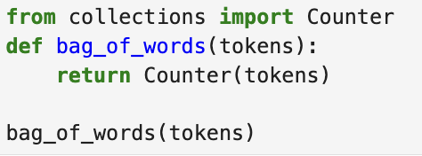
Bag-of-words
The Bag-of-Words model is one of the simplest forms of text representation. Imagine dumping all the words from a text into a bag.
In BoW, the order of words is ignored; what matters is the frequency of each word in the text.
The main advantage of BoW is its simplicity and ease of understanding.
E.g., word frequency analysis
['fake', 'news', 'nytimes', 'tracing', 'coronavirus', 'origin', 'back', 'europe', 'china', 'first', 'fakenews', 'wonder', 'failing', 'new', 'york', 'time', 'got', 'one', 'named', 'source', 'recently', 'thrown', 'china', 'like', 'dog', 'obviously', 'want', 'back', 'sad']
{'back': 2, 'china': 2, 'fake': 1, 'news': 1, 'nytimes': 1, 'tracing': 1, 'coronavirus': 1, 'origin': 1, 'europe': 1, 'first': 1, 'fakenews': 1, 'wonder': 1, 'failing': 1, 'new': 1, 'york': 1, 'time': 1, 'got': 1, 'one': 1, 'named': 1, 'source': 1, 'recently': 1, 'thrown': 1, 'like': 1, 'dog': 1, 'obviously': 1, 'want': 1, 'sad': 1}

Slide 26
2. TF-IDF (Term Frequency Inverse Document Frequency)
TF-IDF takes into account how unique these words are to the documents.
The TF (Term Frequency) part measures how often a term occurs in a document.
The IDF (Inverse Document Frequency): what fraction of documents does the word occur in?
Multiplying TF by IDF results in the TF-IDF score of a word for a particular document, with higher scores indicating greater importance.
[{'the': 1.3862943611198906,
'quick': 0.6931471805599453,
'brown': 1.3862943611198906,
'fox': 1.3862943611198906,
'jumps': 1.3862943611198906,
'over': 0.6931471805599453,
'lazy': 0.6931471805599453,
'dog': 0.6931471805599453},
{'never': 1.3862943611198906,
'jump': 1.3862943611198906,
'over': 0.6931471805599453,
'the': 0.6931471805599453,
'lazy': 0.6931471805599453,
….
1. "The quick brown fox jumps over the lazy dog",
2. "Never jump over the lazy dog quickly",
3. "Bright vixens jump; dozy fowl quack",
4. "Quick wafting zephyrs vex bold Jim"

Slide 27
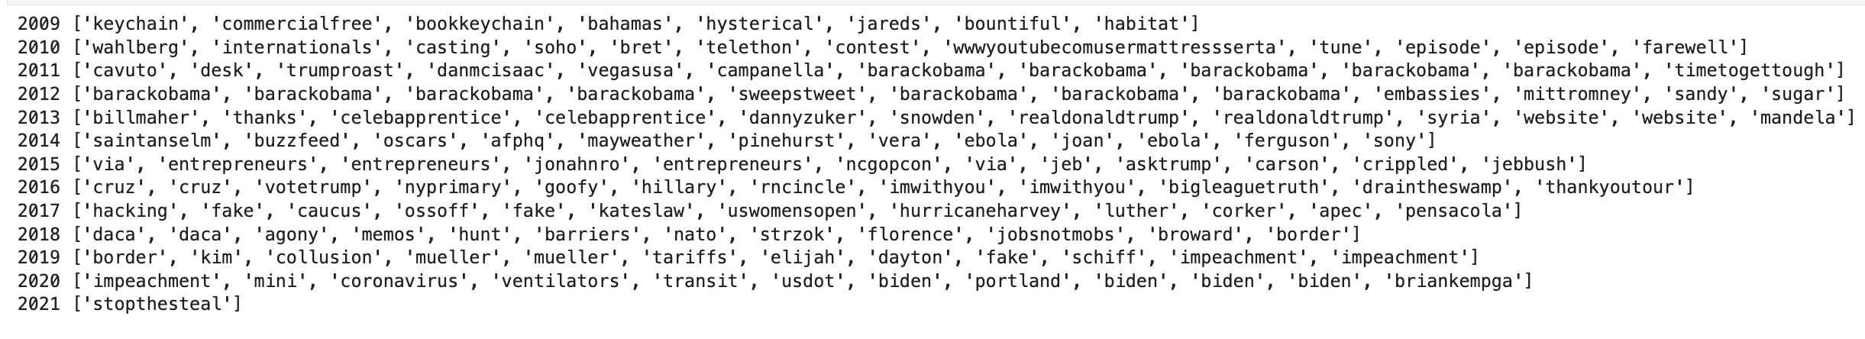
2. TF-IDF of Trump; month by month
While simple, TF-IDF is often enough to give an inductive overview of a set of documents.
What words are most typical of a certain document?
For instance, what Trump talked about month by month:

Slide 28

3. Word embeddings
More advanced technique. Words are mapped to vectors of real numbers in a high-dimensional space. Techniques like Word2Vec or GloVe analyze words within their context, capturing semantic relationships and nuances.
For instance, 'king' and 'queen' will be closer in the vector space than 'king' and 'apple’.
Allows doing math with language! King + woman = queen
The advantage of word embeddings is that they capture the semantic meaning that BoW and TF-IDF miss. Excellent for tasks requiring a deep understanding of language, like sentiment analysis or machine translation. The downside is that they require a lot of data to train.

Slide 29
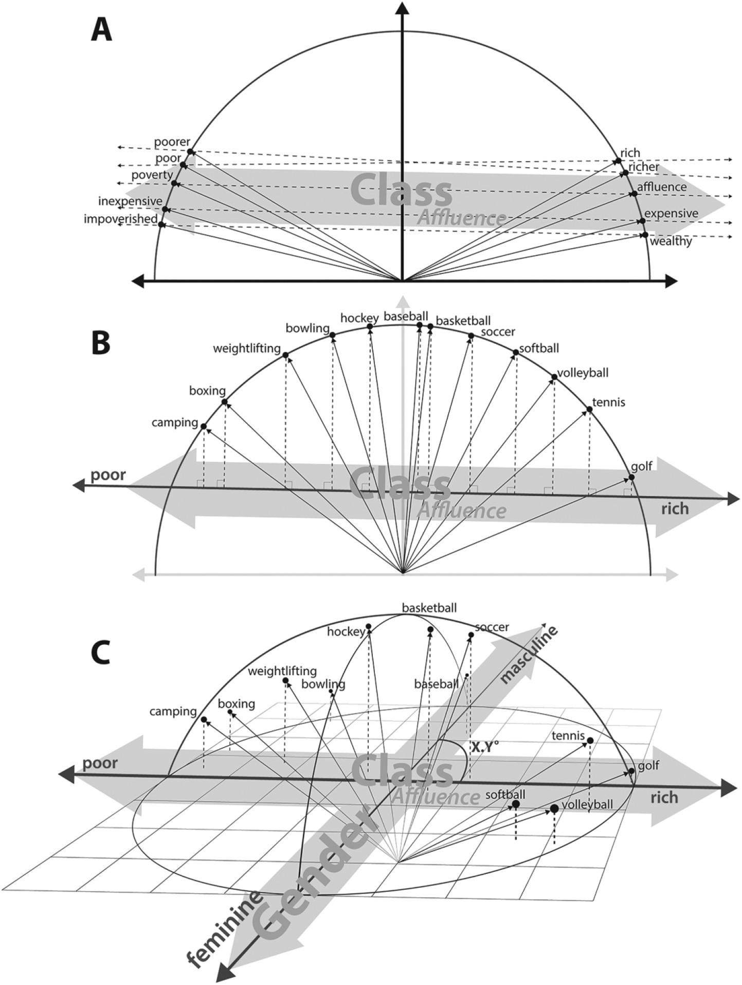
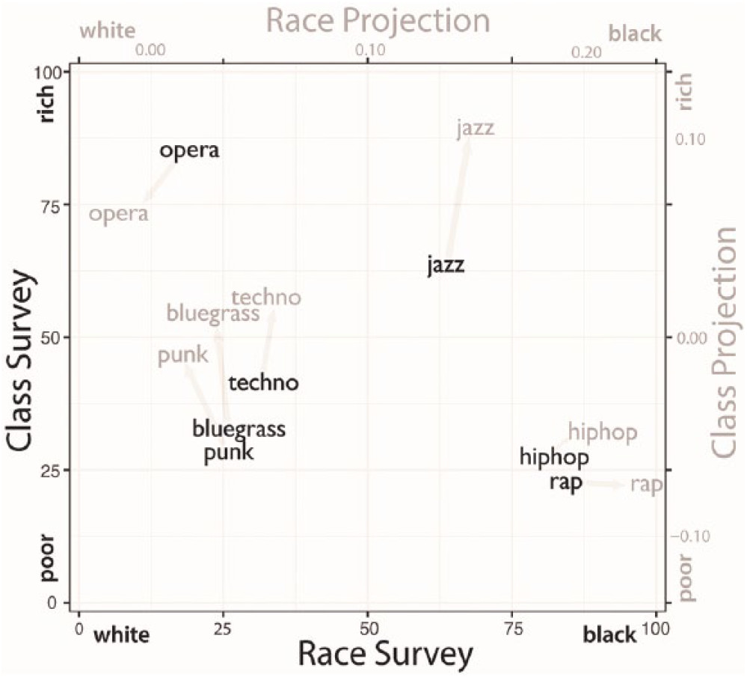

Slide 30
Today’s class
Situating NLP in text analysis
Data cleaning & preprocessing
Text representation / Vectorization
Sentiment analysis
Topic modeling
Machine learning
Large Language Models

Slide 31

Sentiment analysis
Find emotional tone, aimed at understanding the attitudes, opinions, and emotions expressed within an online mention or text.
Approaches for sentiment analysis:
Lexicon-based
Rule-based
Machine learning-based
Deep learning
Sentiment analysis tools and libraries:
Vader, nltk, textblob, Stanford, Hugging Face transformers.
Fine-tuning pre-trained models on specific datasets

Slide 32

Rule-based approach
Includes grammar rules and heuristics.
E.g., VADER (Valence Aware Dictionary and sEntiment Reasoner)
Intensity modifiers: These amplify or reduce the sentiment score (e.g., "extremely good" vs. "good").
Conjunctions: VADER adjusts the sentiment score based on conjunctions like "but" which can change the sentiment of a sentence (e.g., "The product is great, but the service is terrible").
Punctuation: The presence of an exclamation mark can increase the sentiment intensity.
Capitalization: If a word is in all caps, it may indicate increased sentiment intensity (e.g., "GREAT" vs. "great").
Emojis and Emoticons: These are often included in the lexicon with their sentiment score, given their prevalence in social media.
Negations: VADER effectively handles negations, flipping the sentiment of the words that follow (e.g., "not good").
VADER works pretty well… for being so simple.

Slide 33
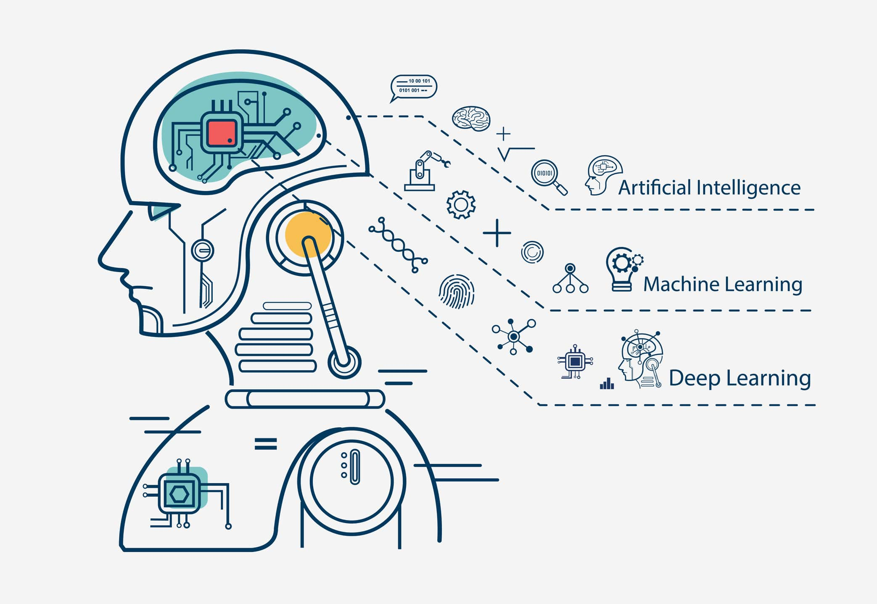
Machine Learning Approach
The machine learning approach to sentiment analysis involves training classifiers using labeled data. Common algorithms include Naive Bayes, Logistic Regression, Support Vector Machines (SVM), and Random Forests.
Upsides:
Accuracy: With sufficient training data, machine learning models can achieve high accuracy.
Feature Learning: These models can automatically learn which features (words or phrases) are most predictive of sentiment.
Scalability: Once trained, they can quickly analyze large volumes of text.
Downsides:
Data Dependency: Performance is heavily dependent on the quantity and quality of the labeled training data.
Feature Engineering: Requires careful feature engineering to capture relevant aspects of the text.
Model Complexity: Some models can become quite complex and may require extensive computational resources.

Slide 34
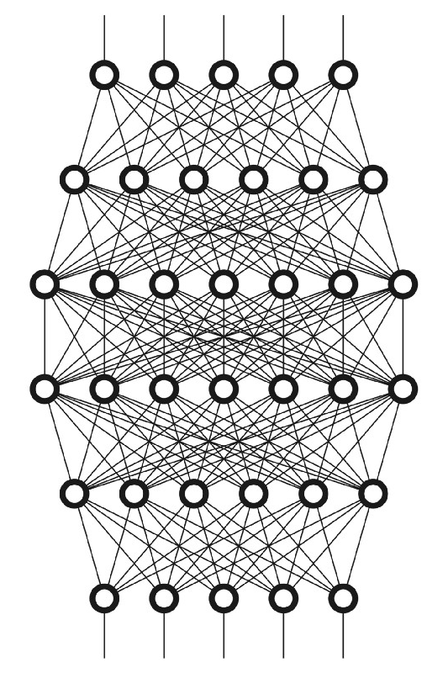
Deep Learning Approach
Deep learning for sentiment analysis usually involves neural networks like Convolutional Neural Networks (CNNs) or Recurrent Neural Networks (RNNs), including Long Short-Term Memory networks (LSTMs), and more recently, transformer models like BERT and GPT.
Upsides:
Contextual Understanding: These models are particularly good at understanding context and the sequence of words in text.
State-of-the-Art Performance: They often outperform traditional machine learning models, especially on complex tasks.
Transfer Learning: Pretrained models like BERT can be fine-tuned with smaller datasets to perform well on specific tasks.
Downsides:
Computational Cost: Training these models from scratch requires significant computational power and time.
Black Box: Deep learning models are often criticized for their lack of interpretability.
Data Hungry: While transfer learning has mitigated this somewhat, deep learning models still benefit from large amounts of data.

Slide 35
How do you choose?
Overall, the choice between these approaches often comes down to a trade-off between accuracy, interpretability, and computational efficiency.
Lexicon-based methods are fast and interpretable but less accurate.
Machine learning strikes a balance but requires careful feature engineering and sufficient labeled data.
Deep learning offers high accuracy and can handle a wide range of complex linguistic features but at the cost of computational resources and often interpretability.

Slide 36


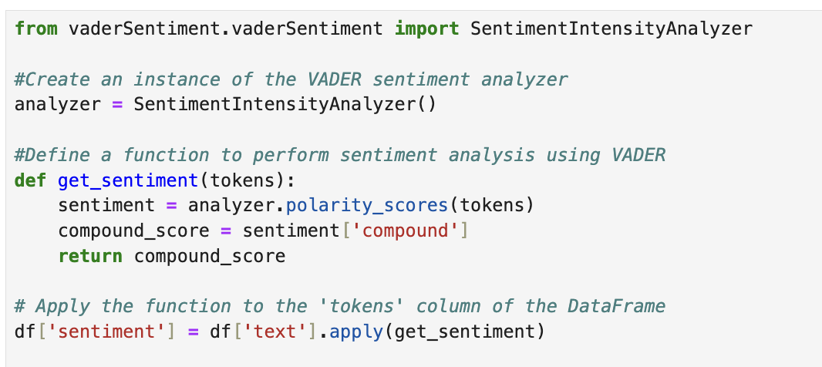

Slide 37
Most Negative
['According to press reports, Iran may be planning an assassination, or other attack, against the United States in retaliation for the killing of terrorist leader Soleimani, which was carried out for his planning a future attack, murdering U.S. Troops, and the death &amp; suffering...’,
'It is outrageous that Poisonous Synthetic Heroin Fentanyl comes pouring into the U.S. Postal System from China. We can, and must, END THIS NOW! The Senate should pass the STOP ACT – and firmly STOP this poison from killing our children and destroying our country. No more delay!’,
'Our prayers are with the people of Vienna after yet another vile act of terrorism in Europe. These evil attacks against innocent people must stop. The U.S. stands with Austria, France, and all of Europe in the fight against terrorists, including radical Islamic terrorists.']
Most positive
['Congratulations to Patrick Reed on his great and courageous MASTERS win! When Patrick had his amazing win at Doral 5 years ago, people saw his great talent, and a bright future ahead. Now he is the Masters Champion!’,
'Today, it was my great honor to proudly accept the endorsement of the @NYCPBA! I have deeply and profoundly admired the brave men and women of the #NYPD for my entire life. New York’s Finest are truly the best of the best — I will NEVER let you down! #MAGA https://t.co/o1l5kAx34v’,
'I am a big fan of Drew Brees. I think he’s truly one of the greatest quarterbacks, but he should not have taken back his original stance on honoring our magnificent American Flag. OLD GLORY is to be revered, cherished, and flown high...']

Slide 38
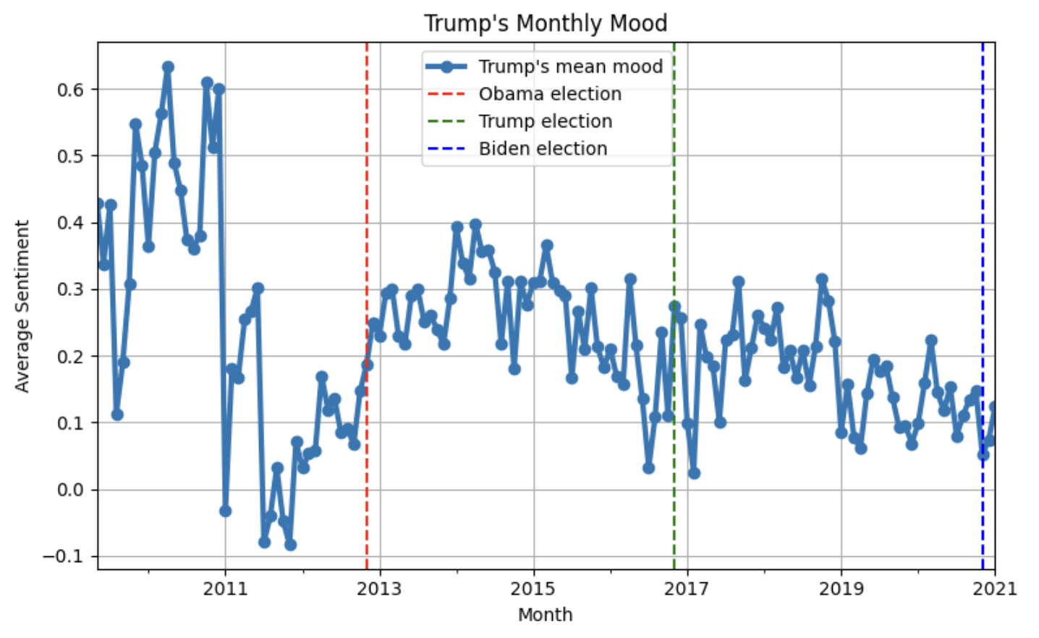

Slide 39
Can you think of some research question that you could use this data to answer?

Slide 40
Today’s class
Situating NLP in text analysis Data cleaning & preprocessing
Text representation / Vectorization
Sentiment analysis
Topic modeling
Machine learning
Large Language Models

Slide 41
Topic modeling
Identify themes or topics in large number of documents.
By analyzing the co-occurrence patterns of words in documents, topic models can infer the presence of underlying topics. Each document is assumed to be a mixture of these topics, and the goal of topic modeling is to uncover this mixture and the words that are most likely to be associated with each of the topics.
Useful for summary, and for discourse analysis

Slide 42
Types of topic modeling
Latent Dirichlet Allocation (LDA): Oldie but goldie. Assumes documents are a mixture of topics and that each word in the document is attributable to the document's topics.
Correlated Topic Model (CTM): An extension of LDA that allows topics to be correlated.
Dynamic Topic Model (DTM): Captures the evolution of topics over time and is useful for analyzing temporal trends in a corpus.
BERTopic leverages BERT embeddings to create dense clusters of similar texts and extract topics from these clusters. Unlike traditional methods that rely on word frequency alone, BERTopic uses contextual embeddings that capture semantic meanings of words within their specific context in a text. This is the dominant method today.

Slide 43
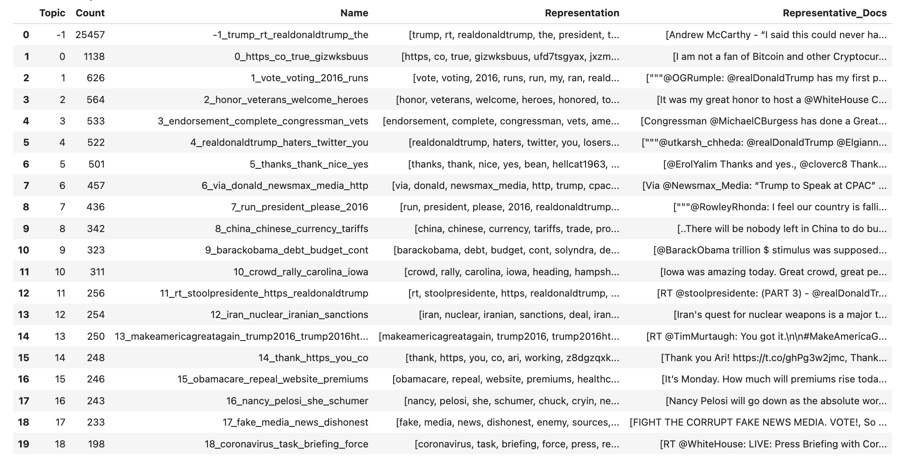

Slide 44
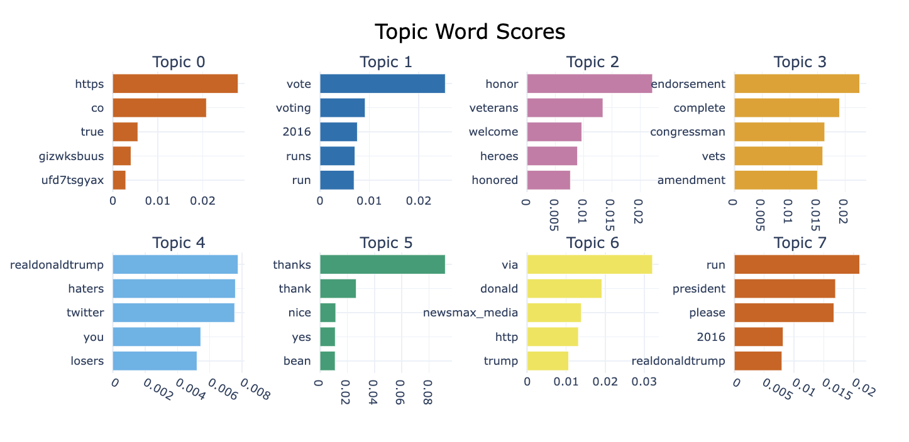

Slide 45
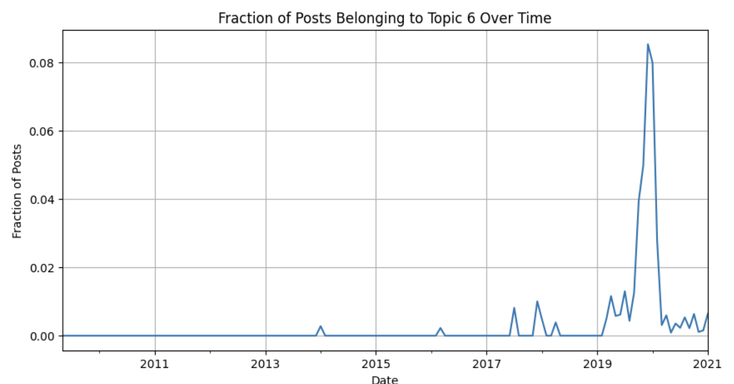
Impeachment topic over time

Slide 46
Today’s class
Situating NLP in text analysis
Data cleaning & preprocessing
Text representation / Vectorization
Sentiment analysis
Topic modeling
Machine learning
Large Language Models

Slide 47
Machine Learning
Machine learning is highly versatile: can do a whole range of prediction, and annotation tasks.
You usually manually classify a lot of tweets, and then train the ML on this data.
By learning from examples, these models can process and analyze large volumes of text data to support decision-making, generate recommendations, or understand human language nuances.
For example:
How toxic is the language?
Is the tweet focused on electoral politics?

Slide 48
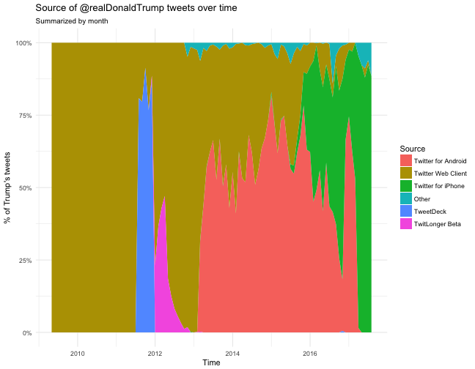
Example: Donald Trump’s devices

Slide 49
precision recall f1-score support
Twitter for Android 0.78 0.37 0.50 1411
Twitter for iPhone 0.85 0.97 0.91 5373
accuracy 0.85 6784
macro avg 0.82 0.67 0.71 6784
weighted avg 0.84 0.85 0.82 6784
We can guess surprisingly well from which device he sent the message

Slide 50
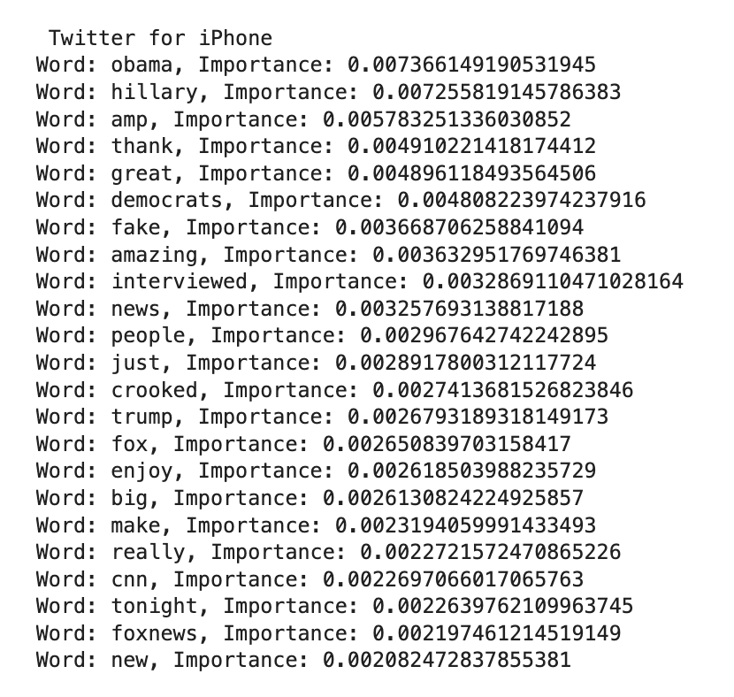
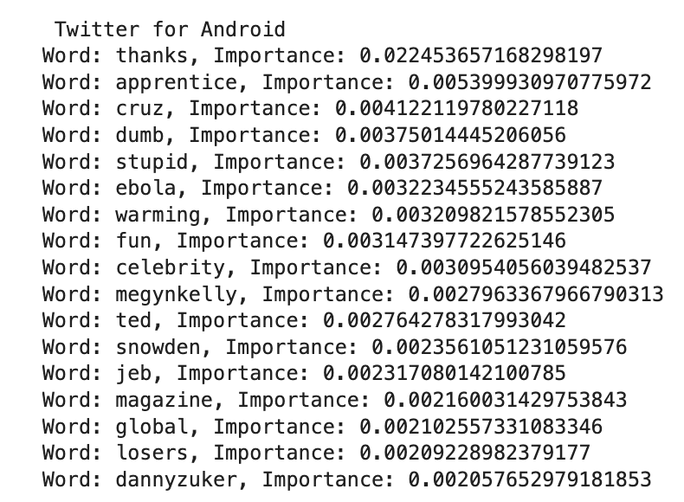
Most important words for the two groups
Which account is Trump, and which is his aids?

Slide 51
Today’s class
Situating NLP in text analysis (quant, qual, and NLP)
Data cleaning & preprocessing
Text representation / Vectorization
Sentiment analysis
Topic modeling
Machine learning
Large Language Models

Slide 52

Large Language models are taking over

Slide 53

Model | Accuracy | F1 Score
Zero-shot GPT4 | 0.894 | 0.898
Naïve Bayes | 0.766 | 0.741
BERT | 0.828 | 0.822
MTurk average | 0.804 | 0.820
MTurk plurality | 0.854 | 0.866
Experts average | 0.830 | 0.837
Experts plurality | 0.860 | 0.855
ChatGPT outperformed everyone, even human experts
Across national contexts and languages, LLMs outperform everyone.
They are better than humans even at “distinctly human capacities”, such as subjective interpretation, contextual inferences, implicit meaning…
Törnberg, P. (2023). Chatgpt-4 outperforms experts and crowd workers in annotating political twitter messages with zero-shot learning. arXiv preprint arXiv:2304.06588.
Notes:
And I was quite surprised by my results.
And I found that ChatGPT had higher accuracy and F1 score than people with PhDs in political science.
And it works well across countries and languages.
But more interestingly, I found that the method showed interpretative capacities that have long been considered “distinctly human”:
things like putting yourself in the shoes of the author, contextual inferences, subjective interpretation, implicit meaning.
There’s the long-standing argument that these things will never be possible measure.

Slide 54
LLMS can carry out nearly any text analysis task
Easy to use. Simply call the API with a text analysis request:
User: “What is the emotional sentiment expressed in the following Twitter message. Respond only with the name of the feeling.
'I feel a profound warmth in my heart when I see you, a gentle stirring, it courses through my veins, filling every fiber with a radiant light that only the heart can understand and only the soul can express.’”
ChatGPT: “Love”

Slide 55

Paradigm SHIft in the making?
An explosion of use. The ease-of-use, high accuracy, and relatively low costs of LLMs have meant that they have become hugely popular.
While computational methods have before made social science more and more technically challenging, LLMs have had the opposite result: empowering qualitative scholars.
Every underfunded ECR can now afford coding huge datasets!
Notes:
Pardigm shift in the making
So, LLMs seem to bring something quite revolutionary to bear.
And there’s been an explosion of work. The ease-of-use, high accuracy, and relatively low costs of LLMs have meant that they have become hugely popular.
In some ways, this is really exciting. Especially that qualitative researchers who’ve never used computational methods before are starting do work with these methods.
While computational methods have before made social science more and more technical, LLMs have had the opposite result: empowering qualitative scholars.

Slide 56

Wild West of
LLM-based
text annotation
Notes:
But there’s also a problem: the field has become something of an academic Wild West, as the lack of established standards has meant that both researchers and reviewers lack benchmarks for LLM-based annotation:
-leading to risks of low-quality research and the publishing of invalid results.
-it often leads to really low-quality reviews, because scholars don’t have experience with these method, so you receive really terrible comments.

Slide 57
Advantages with LLMs
Powerful, versatile, no training data required
Easy to use
Bridges quant and qual by enabling computational interpretation

Slide 58
Criticisms of LLMs
More expensive and slower than supervised models
LLM are capable, but also more challenging to use than they may seem: prone to bias, misunderstandings, and unreliable results.
Researchers have varying levels of success (Rathje et al., 2023 ; Pangakis et al. 2023)
Some argue that we should not use them at all: “unreliable and incompatible with the principles of open science" (e.g., Kristensen-McLachlan et al 2023).
Notes:
LLMs fit poorly into our existing ways of thinking of computational text analysis, and many of the lessons from machine learning are hence obsolete.
While LLMs are intuitive and easy to use, the simplicity can be risky as they are also prone to bias, misunderstandings, and unreliable results – leading some researchers to even warn against using the models for annotation
There has of course since been a great debate in the literature since then,
with people trying it, and some people finding that it’s amazing, and others that it’s not reliable.
As is often the case, some have argued that we shouldn’t use it.

Slide 59

SOLUTION
We should neither be uncritical nor reject their use: but need to structure, direct and formalize their use in ways that draws benefits from their capacities, and manage their risks.
We need a sheriff in town!

Slide 60

The 8 commandments of LLM text annotation
Choose an appropriate model (probably not ChatGPT)
Follow a structured coding process
Develop a Prompt Codebook
Validate your model,
Use structured prompts
Consider ethical and legal implications
Prompt stability analysis
Consider that your data may be in the training data.
Petter Törnberg. 2024. Best Practices for Text Annotation with Large Language Models. ArXiv.

Slide 61
LLM in practice
This week, we will just test this through the web interface
I will however also provide a guide for how to use LLMs through the API
In week 5, we will use the LLM to annotate data and then train a machine learning model on it.

Slide 62
Today’s class
Situating NLP in text analysis (quant, qual, and NLP)
Data cleaning & preprocessing
Text representation / Vectorization
Sentiment analysis
Topic modeling
Machine learning
Large Language Models
Extra: Case study 1: Race & Airbnb in New York City

Slide 63
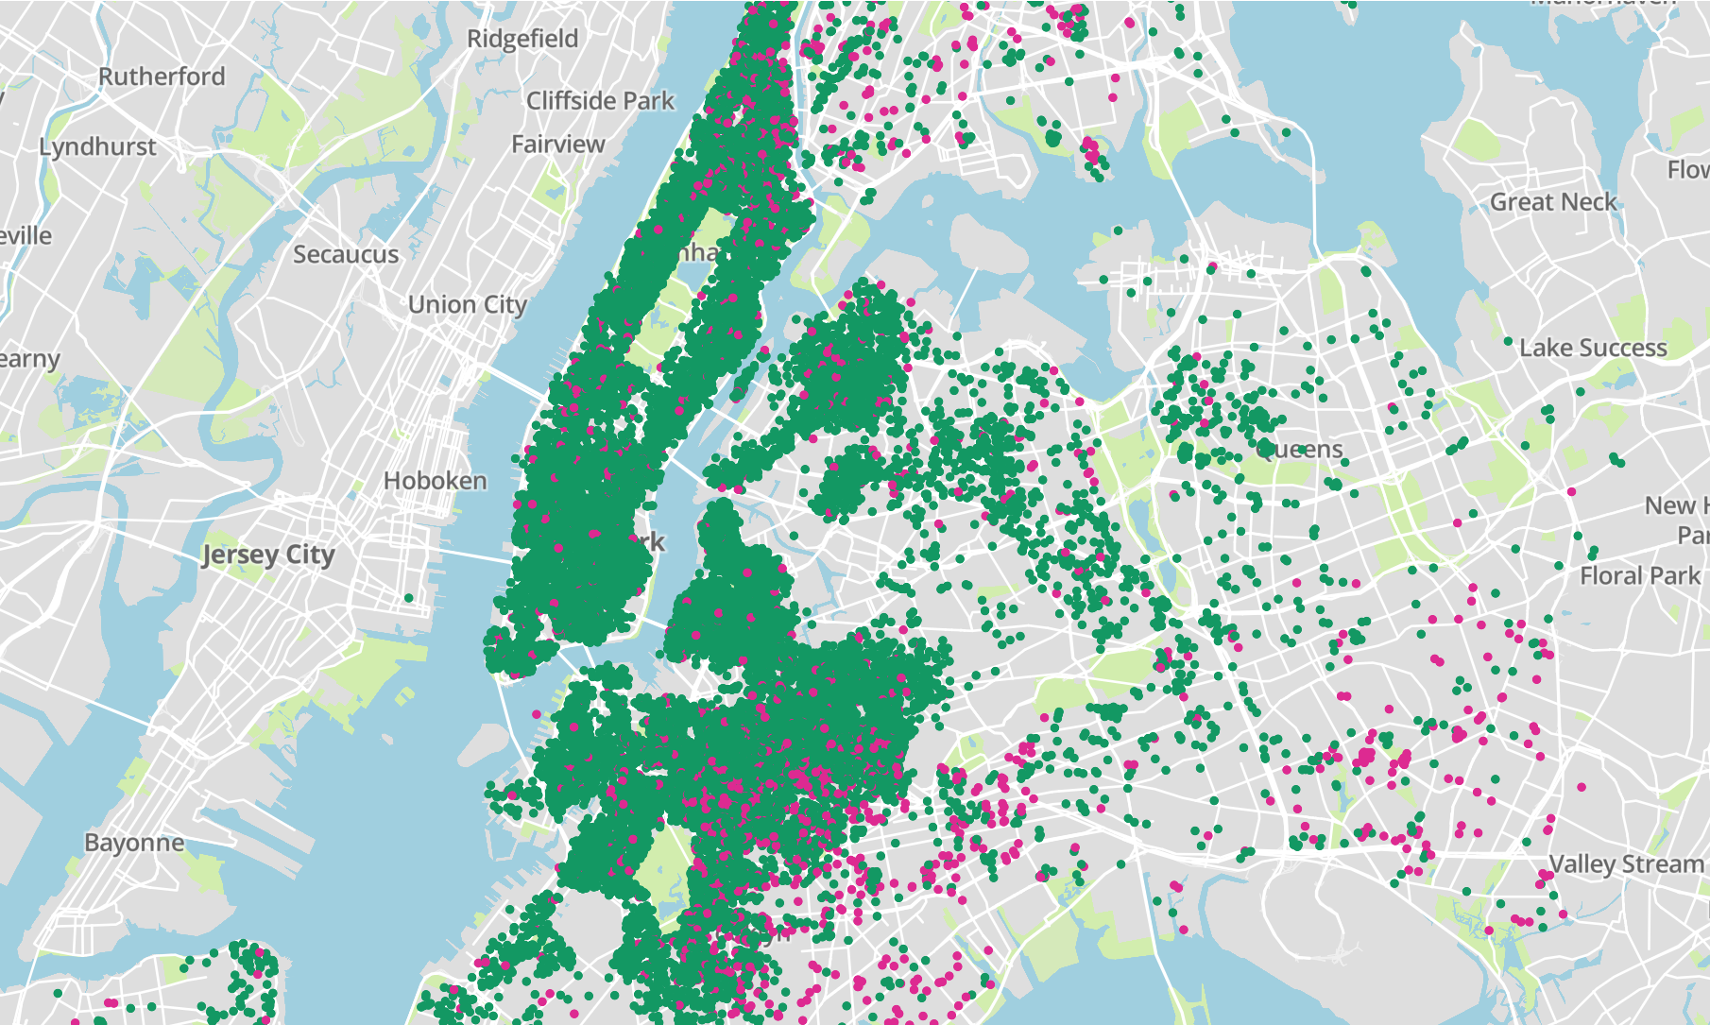
New York City
There are 44,317 apartments
Owned by 37,108 hosts.
Reviewed 801,784 times,
703,685 reviewers.

Slide 64
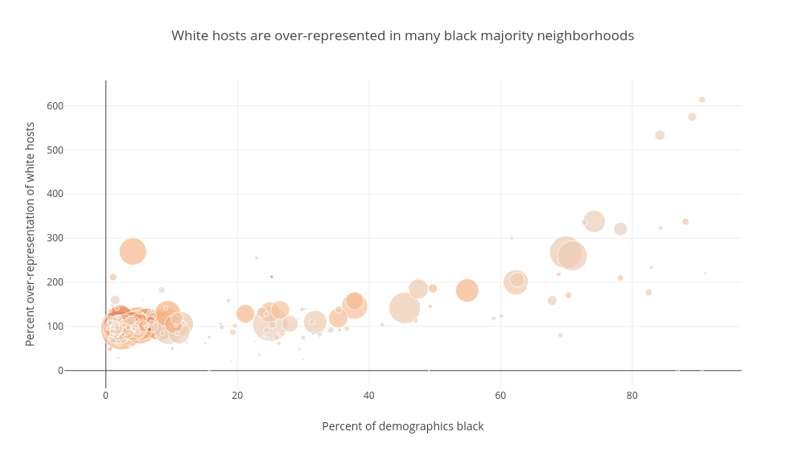

Slide 65
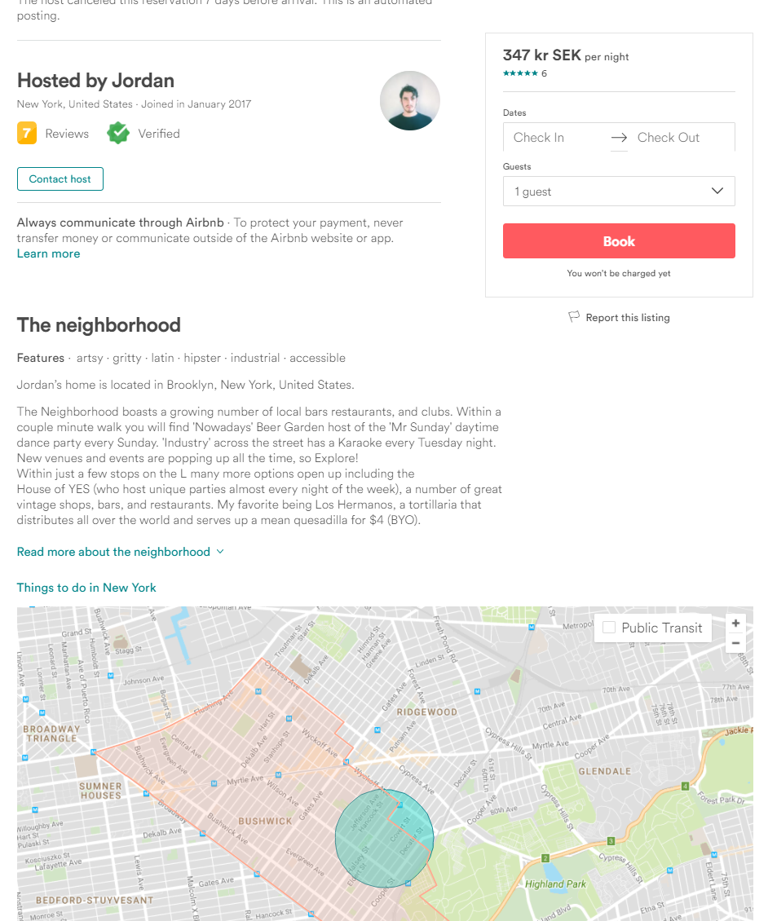
Hosts framing neighborhoods

Slide 66
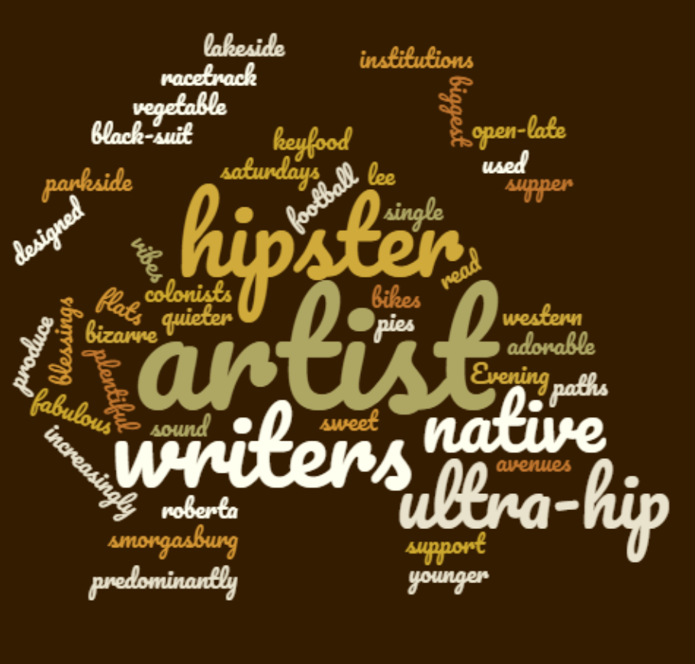
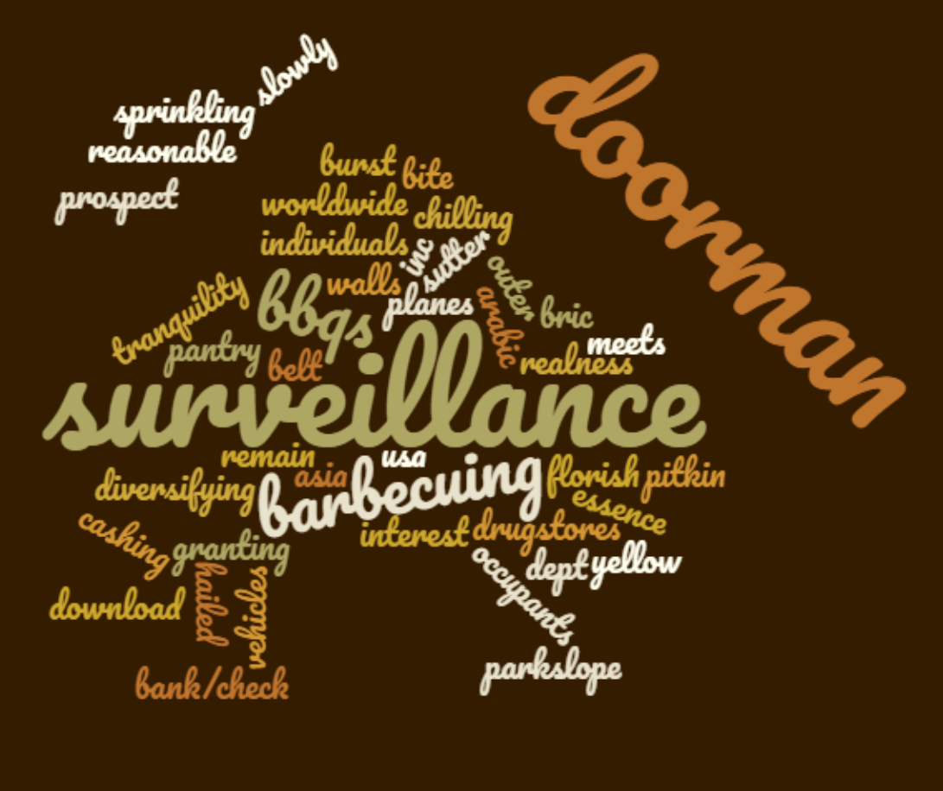
Most overrepresented words
BLACK HOSTS
WHITE HOSTS

Slide 67
Topics as a function of host race
White
15 | brooklyn park prospect restaurants bars museum neighborhood great coffee shops
18 | park restaurants neighborhood central walk great away bars minute manhattan
19 | busy general block day native trains possibility away may times
21 | min away walk restaurants park neighborhood central airport many manhattan
22 | book harlem neighborhood well renowned restaurants five white shops busses
22 | park blocks central restaurants area harlem away neighborhood new bars
22 | johns forest diversity simple st commons part several new borough
22 | area brooklyn lenox neighborhood restaurant views avenue dinner located museum
32 | neighborhood also police located around rd quiet block accessible middle
34 | miles restaurants min park th distance walking green street st
40 | acres security india drinks doorman city town rest door via
47 | park away central shopping transportation jamaica casino close neighborhood walking
48 | neighborhood stores safe working kinds restaurants long drug street jamaican
51 | jfk minutes airport away mall stores shopping several supermarkets green
57 | parking salons jamaica neighborhood hair vehicles class safe free years
% black
Black

Slide 68
“this neighborhood is a diamond in the rough, especially in the Summer months you will get that Brooklyn authenticity of people chilling, hanging out, barbecuing and enjoying the weather until the small hours of the morning. If you can’t ‘walk like you belong’, then this isn’t the location for you . . . ”
Ocean Hill, Brooklyn
“This area is well-suited for travelers who want the authentic New York experience. Perfect for any palette- Jamaican bakeries, hipster coffee shops, asian restaurants, 24/7 bodegas, bars, and organic grocery stores are all within walking distance”
Prospect Lefferts Gardens-Wingate, Brooklyn
“Bushwick has been recently named as the new Soho. A neighborhood full of graffiti art, alternative art galleries, artist studios, bars, coffee places and restaurants. Close to Williamsburg, a vibrant hipster neighborhood with restaurants, bars, flee markets, concert venues.”
Stuyvesant Heights, Brooklyn
“What I love about my neighborhood is that, although there is a coffee shop and a wine store just down the street, the hipsters haven't yet fully taken over, and the neighborhood still has more of an authentic Brooklyn feel to it. There are always people hanging out on their stoops, and everyone you pass greets you.” Stuyvesant Heights, Brooklyn
“Bedford-Stuyvesant (‘Bed-Stuy’) is a vibrant, constantly growing community in central Brooklyn, New York. In the last five years, this middle-class neighborhood has exploded with a diverse mix of students, artists, professionals and hipsters of all races, mixing in with the existing neighborly, predominantly African American community.”
Stuyvesant Heights, Brooklyn
Airbnb as a Platform for Gentrification
White hosts
Petter Törnberg
Letizia Chiappini

Slide 69
Black hosts
'The feeling of safety as you walk outside and realize that a police station is directly across the street gives me an extra sense of security.’, Stuyvesant Heights, Brooklyn
“The neighborhood is very safe, well-populated, highly residential, family-oriented and is routinely patrolled by local NYPD. Various transportation options are nearby.”, Central Harlem South, Manhattan
“Relatively safe”, Baisley Park, Queens
“Family oriented neighborhood. Close access to a Grocery Store, Family Dollar, and on street parking.”, Stuyvesant Heights, Brooklyn
“If you are not opposed the ethnic and racial diversity my property of in fact New York is not for you.”, Stuyvesant Heights, Brooklyn
“*** TO BE CLEAR, this is a Black neighborhood. We are Black people. We wouldn't mention this if it wasn't an issue with some renters in the past. Bigots need not apply :)”,
Prospect Lefferts Gardens-Wingate, Brooklyn
Airbnb as a Platform for Gentrification
Petter Törnberg
Letizia Chiappini

Slide 70
NLP can be used as part of a critical discourse analysis approach
Edward Said's concept of colonial discourse, as presented in his seminal work "Orientalism," posits that the way the West talks about the East (the Orient) is not an objective description but a 'discourse' shaped by political forces. This discourse reflects the power dynamics of colonialism, where the West constructed knowledge about the East that reinforced its own superiority and justified colonial rule. Said argues that this discourse is not only a reflection of power but also a means of exerting it, as it shapes perceptions and understanding of Eastern societies, often depicting them as exotic, backward, and in need of Western intervention or control.
Our understanding of the Other is shaped by the economic and power interests of the powerful.
Gentrified neighborhoods are the urban stages of colonial expansion. Blackness is marketed as a consumption experience.

